Slide 1
Tradition, Method, Madness and Theory
Finding Literature
Critical
Theory

Slide 2


Slide 3
The Paper
Literature Review
What is a Literature Review:
        Not to be confused with a book review, a literature review surveys scholarly articles, books and other sources (e.g. dissertations, conference proceedings) relevant to a particular issue, area of research, or theory, providing a description, summary, and critical evaluation of each work. The purpose is to offer an overview of significant literature published on a topic.

Slide 4

Where to find Literature

Slide 5
What to look for
Peer-Reviewed Journal Articles
BOOKS-Print or E-Books
Google Books are OK to look at and gather information

Slide 6
Tips
When you find an article that is helpful, look at the paper’s bibliography.
If you notice books and papers on your subject mention the same people, it means you should have those people in your paper.
Skim, Scan, Close Read
Introductions and Conclusions are helpful in journal articles.]
  Why they did the study
  What their study found
  You synthesize with the other research to conclude the importance.

Slide 7
How a Literature Review is different
A literature review shows the foundation and support
Summarize and Synthesize arguments and ideas of others without adding new contributions
You will use this Literature review to lay the foundation for your longer research paper.
What this paper is NOT: You are not arguing. You are simply showing the research that others have done to help us better understand.

Slide 8
APA (American Psychological Association)
http://owl.english.purdue.edu/owl/resource/560/01/
Types of papers: http://owl.english.purdue.edu/owl/resource/560/13/

Slide 9
Texts Influence Through Meanings
We think or act in certain ways in response to texts because of meanings that the texts have for us and the meanings that texts urge us to attribute to our experience.

Slide 10
What is a critic:
Their role is to explain what texts mean
Best and analyses show ranges of meanings and may explain the way s in which certain texts are sites of struggle over meaning.

Slide 11
The Critical Character:
Attitude: People in critical studies want to know what else is going on besides the obvious.
The critical scholar must be prepared to dig into texts, to think about the ways that people are being influenced as well as entertained informed, etc. by texts.

Slide 12
The Critical Character
Method: Critical studies is a METHOD.
A way of asking certain kinds of questions about whatever is being studied.
  What does this text mean to different people?
  1. Critics explain the rhetoric of popular culture, what texts and artifacts mean are the ways in which they influence people.
  2. Critics showing how to experience life by demonstrating how texts and artifacts might be understood, the meanings that can be found in them.

Slide 13
Culture-Centered
Every culture contains its own methods of critical analysis, its own questions and probes to be brought to bear on the artifct being examined.
Ethonocentric criticism: practice of looking at the artifacts of other cultures and judging them only from the perspective of one’s own culture.

Slide 14
Culture Centered Method
Values
The ways of understanding and thinking
Aesthetics that are characteristic of a given culture

Slide 15
Marxist
Focuses on the notion that material conditions and economic practices shape the dominant ideology about who OUGHT TO BE and OUGHT NOT TO BE empowered.
The goal of a Marxist critic is to expose how popular culture texts reinforce status quo power structures as normal and common sense.
LIBERATE OPPRESSED GROUPS

Slide 16
Marxist: Ideology and Hegemony
Ideology: a cultural group’s perceptions about the way things ARE and their ASSUMPTIONS about the way things OUGHT TO BE.
  Marxist: a false set of ideas perpetuated by dominant political forces (Littlejohn & Foss, 2008, p. 331).
Hegemony: is the privileging of a dominant group’s ideology over that of other groups.
    Ex. USA the dominant culture group is defined in terms of socioeconomic status, race, and gender.
    Hegemony supports the interests of those in power

Slide 17
Marxist: Materialism and Economic Metaphors
Materialism is the philosophy that grounds the Marxist theory.
Marxist materialism today posits that ALL ideas, rules, laws, norms, customs, and social practices of a given society come to be based on real, concrete, observable objects, conditions and practices.
Economic metaphor: includes anything that signifies something about the culture’s ideas, norms, values, practices, etc.
  Marxist critic of mediated pop culture: examine how this practice is communicated in music, on TV, in ads, movies, because mass media disseminates the ideas and worldviews of the ruling class while denying alternative ideas.

Slide 18
Preferred or Oppositional readings
Preferred Reading: Most obvious, common sense interpretation of a pop culture text
Oppositional Reading: Opppose the dominant ideology with regard to our taken for granted beliefs about empowerment.
  Subverted oppositional reading: reject hegemony outright (Dances with Wolves)
  Inflected oppositional reading: messages represent a mere bending of hegemony to suit one’s own needs, rather than an outright rejection of it.
      Example: The Cosby Show. The Huxtables were of high socioeconomic status and they lived in a nice home. (preferred reading)
      Oppositional reading—the program opposed hegemony in terms of race economic metaphor, but supported it with all the other economic metaphors.
American Express Commercial
MasterCard Commercial

Slide 19
Feminist perspective
Focuses on the taken for ranted as normal roles and rules for men and women in society.
Similar to Marxist perspective: suggests that a dominant ideology controls what people believe as common sense.
Focoses on the privileging of men and a masculine perspective over women and a feminine perspective.
The hegemony (the dominant American ideology) which is reinforced BOTH by women and men—simultaneously empowers men and opresses women.
A feminist is ANYONE (male or female) whose beliefs and actions counter the hegemony in that they respect and value women and a feminine perspective.
Mad Men (Netflix)

Slide 20
Liberal Feminist Perspective
Focuses primarily on providing opportunities for the inclusion of women in traditionally male-dominated areas.
I Don’t Know How She Does It
    She’s empowered in the workplace, but they also show how unhappy she is. Reinforcing the patriarchy and how unhappy she is in her professional role because to be truly happy, she would be a stay at home mom.

Slide 21
Radical Feminist Perspective
Girls are told– look lady like, act ladylike
Boys—Don’t cry, and to take it like a man.
GENDER ROLES and how oppression stems from these gender identities
Both boys and girls learn that boys are supposed to be the SUBJECTS in their worlds, whereas, girls are supposed to be OBJECTS.
Radical feminist critique is to reveal these unconscious causes of women’s oppression and then eradicate or transform them.

Slide 22
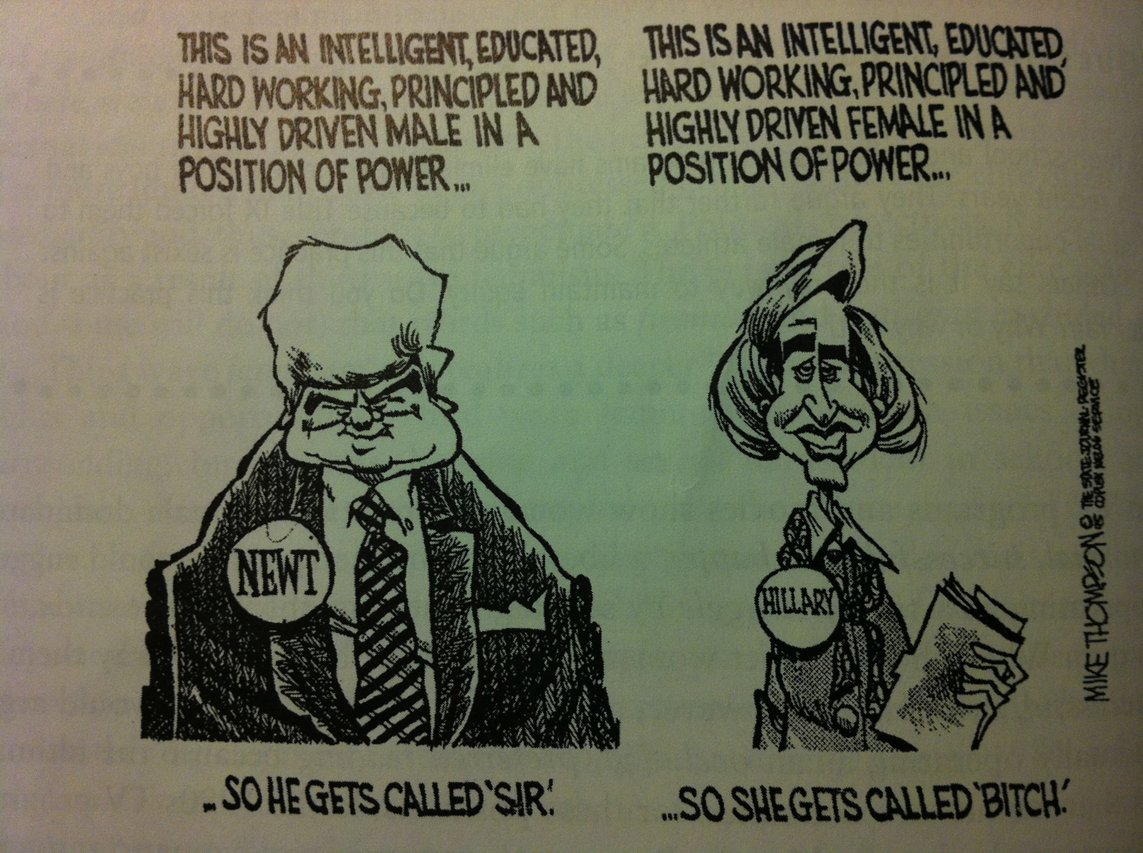
Radical Feminist Perspective

Slide 23
Marxist Feminist Perspective
Seeks to ensure economic equality for women, that is, equal work for equal pay.
Male sports bring in more money and spectators than female sports.
Identify a TV program where a woman works outside the home? Does she work full time or part time? Did she take time off? Children? Did she enter her career later in life? Is she happy? What does this program teach viewers from a Marxist feminist perspective?

Slide 24
Cultural Feminist Perspective
This perspective seeks to promote as valuable socialized skills, activities, behaviors, and viewpoints that have traditionally been defined as feminine and , thus, trivialized.
Cooking, cleaning, sewing, etc, are a woman’s job.
Cultural feminists believe that stereotypical feminine skills, activities, behaviors, and characteristics are valuable and should be embraced by both women and men.
Mr. Mom

Slide 25
Waves of Feminism
First Wave Feminism: 19th century led by Susan B. Anthony, Margaret Sanger, Anna Howard Shaw and Elizabeth Cady Stanton.
      Secure women the right to vote (1920 w/ the passage of the 19th amendment)
Second Wave Feminism (1963) : focuses on the goals of equal rights and opportunities for women and men. Title IX now promotes equal opportunities in H.S. and college sports. (Bra Burner)
Third Wave Feminism (1980’s): focuses on women’s issues but also on a variety of standpoints.
Post Feminism: A healthy rewriting of what is feminism because it is changing and transforming and continuously in process.
    The Bachelorette

Slide 26
StandPoint Theory
Argues that the world may be known only in partial perspectives given to us by our situation in the world in terms of class, race, gender, geography, sexual identity, and so forth.
Understanding of the world shaped by where we are situated within it (our life experiences) based on class, gender, race, sexual identity, and so on.

