Slide 1
Rhetoric and Popular Culture

Slide 2
Rhetoric
The ways in which signs influence people (page 4)
Rhetoric is “the art of winning the soul by discourse” –Plato
Rhetoric is “the faculty of discovering in any particular case all of the available means of persuasion”—Aristotle
“Rhetoric is the art of speaking well” or “Good man speaking well.”-Quintilian
Rhetoric is the study of misunderstandings and their remedies.-A.Richards
“Rhetoric is a form of reasoning about probabilities, based on assumptions people share as members of a community.” Erika Lindemann
Rhetoric is the art, practice and study of human communication—Andrea Lundsford
Rhetoric is an action human beings perform when they use symbols for the purpose of communicating with one another… [and it]is a perspective humans take that involves focusing on symbolic processes. –Sonja and Karen Foss

Slide 3
Four Advantages for studying Rhetoric
To help us perceive the difference between true and false
To help us understand how people are moved to action
To help us see both sides of an issue
To help us defend ourselves against the arguments of others.

Slide 4
Shift in Rhetoric
GREAT ORATORY of PUBLIC SPEAKING—Ancient times
Music, film, television, and the Internet

Slide 5
Power
Ability to control events and meanings
Used to thinking certain people or groups or classes of people have powers.
        President of United States
        Steve Jobs
        Supreme Court Justice
        Your Boss
        Your Professor
Women vs. Men—Gender Roles
        A working woman who leaves work early and picks up their sick child is compromising their career
        A man who leaves work early to pick up their sick child is caring, responsible and sensitive.
“Everyday actions, objects, and experiences are really battlefields—sites of struggle among political and social forces. (Brummett pg. 5).

Slide 6
Power and Privilege
May foster a sense of privilege
      People of European heritage have had privilege in the U.S.
      Men have enjoyed privilege
Those who benefit usually the least aware of it
      Example: Who can marry
      Popular culture shows heterosexual couples in ads, movies, television
Influences
      Ads
      News
      Internet
      Television Shows
      Family
      Church

Slide 7
Power and Privilege
Ideas were acquired over time through
              INFLUENCE
              EXPERIENCES

Slide 8
SIGNS
EVERYTHING is a sign—Chalres Sanders Pierce
A sign induces you to think about something other than itself

Slide 9
Semiotics
Semiotics is the study of signs and symbols and their use or interpretation.
What does a certain structure (Text, Genre, etc) mean?
How does it represent what it means?
Why does it mean what it means?

Slide 10
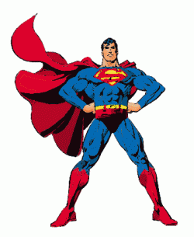
Who are what does Superman represent
‘hero’ in the tradition of mythic superhuman heroes, such as Prometheus and Hercules.

Slide 11
How does Superman represent what it means
Exemplifies
  Truth
  Justice
  And the American Way

Slide 12
Why does Superman have the meaning that he has?
Origin of the hero:
  A hero is an individual, often of divine ancestry, who is endowed with GREAT courage and strength, celebrated for his bold exploits, and sent by the gods to Earth to play a crucial role in human affairs.

Slide 13
Superman
He is a ‘recycled’ or ‘mediated’ hero

Slide 14
Denotative (Literal or Primary meaning | Connotative (an idea or feeling a word invokes—Cultural history behind it)
He has unusual physical powers (he can fly; he cannot be harmed by human weapons; etc) | He acquired these powers by vitue of the fact that he is not of this world.
He helps good people in trouble and defeats the villains | Heroes have been sent from another world to help humans run their affairs. They embody human virtues.
He is rendered powerless and vulnerable by exposure to kryptonite | Heroes have a tragic flaw, which is an acknowledgement of the belief that all things of this world (including good things) are ultimately imperfect.
He wears an unusual costume | Clothing sets heroes apart from common folk. This is also why military personnel and clerics, for instance wear different types of clothing. Clothing sets leaders apart from those who depend on them.

Slide 15
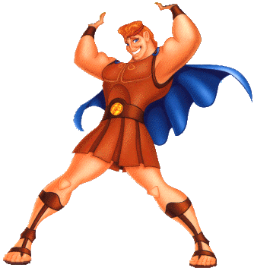
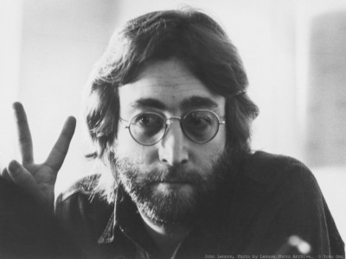
Types of signs
Icons
      A sign that resembles its referent in some way.
        Onomatopoeic words, ‘drip’, ‘plop’ ‘bang’
        Portraits of people
        Superman has been devised to look like past heroic figures
Indexes
      A sign that stands FOR, or POINTS out, something in relation to something else.
        Pointing index finger-shows to locate something.
        Our names
        Superman uses Clark Kent which identifies him as a member of American Society and not say, Spain society.
Symbols
      Is a sign that stands for something in an arbitrary way, in other words, based upon agreement and learned through experience convention based way.
        Colors

Slide 16
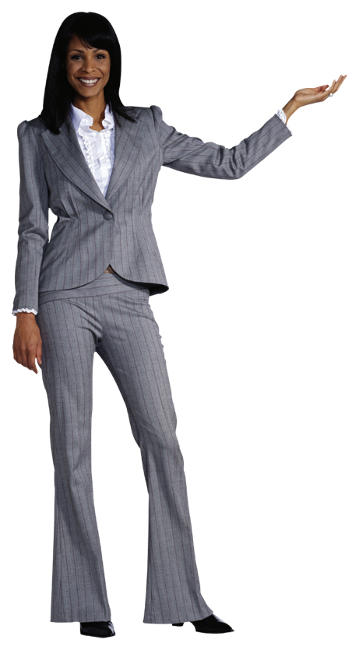
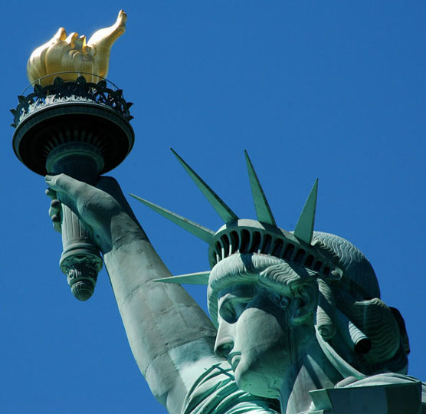

Iconic, Index or Symbol

Slide 17

Cultural Artifacts
What is an artifact:
An action, event, or object perceived as a unified whole
Having widely shared meanings
Manifesting group identification to us

Slide 18
Characteristics of Artifacts
Artifacts are a socially created reality
Signs become artifacts as they become charged with meaning. Thus crossing a threshold into artifact status.
An artifact can be very complex, even made up of other artifacts.
Artifacts are the material signs of group identifications

Slide 19
Culture
Oxford dictionary (1972):
The training, development, and refinement of mind, tastes, and manners; the condition of being thus trained and refined; the intellectual side of civilization.
HIGH CULTURE
Opera
Education
Art
New definition: “the civilization, customs, artistic achievements, etc. of people especially at a certain stage of its development.”

Slide 20
Popular Meanings of Culture
Culture is that which sustains and nourishes those who live and move within it.
Raymond Williams (academic): “ as a very active world of everyday conversation and exchange. Jokes, idioms, characteristic forms not just of everyday dress but occasional dress, people consciously having a party, making a do, marking an occasion.
              Similar to the Ritual of Communication
What makes a group of artifacts into culture is that they are systematically related. They make up a system of artifacts anchored in group identifications.
            Part of everyday experience of most people ( Facebook?)

Slide 21
Characteristics of Cultures
Cultures are highly complex and overlapping
Cultures entail consciousness or ideologies
Cultures are experienced through texts

